Slide 1


Super Bowl 52: A Census of Players
A fun data visualization exploring the geographic origins of Super Bowl 52 players, highlighting their hometowns and populations.
Notes:
1

Slide 2
Where Did Super Bowl 52 Players Come From?
Super Bowl 52, a clash between the Philadelphia Eagles and the New England Patriots, boasted a diverse range of players from across the nation.
This dataset showcases the distribution of player birthplaces, revealing geographic trends and highlighting the national scope of the game.
Notes:
2

Slide 3
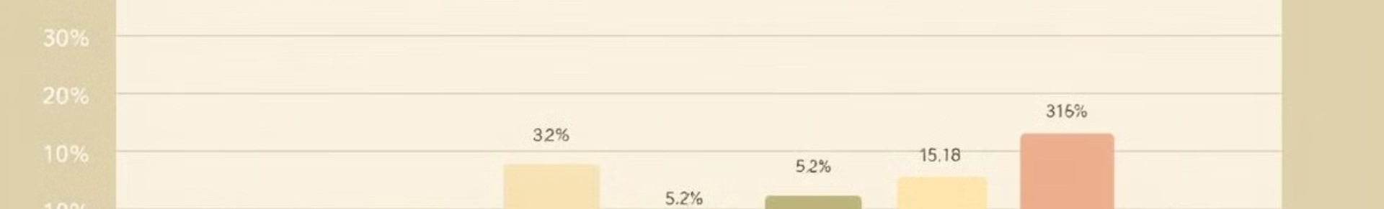
Population Figures Behind the Birthplaces
30M
20M
California
Texas
The Golden State boasts a significant population, contributing numerous players to the Super Bowl.
The Lone Star State is another major contributor to the NFL, with numerous players hailing from its cities.
15M
12M
Florida
New York
Florida's sunny climate and strong athletic programs attract athletes and contribute to its representation in the NFL.
The Empire State, with its rich history of football, continues to produce talented players for the NFL.
Notes:
3

Slide 4






Embedded Links to Additional Census Data
Global
Urban
Explore global population trends and how they impact the sports landscape.
Dive deeper into the demographics of specific cities and their influence on sports.
Trends
Regional
Analyze data trends over time and their implications for the future of sports.
Discover regional differences in population and their impact on sports participation.
Notes:
4

Slide 5
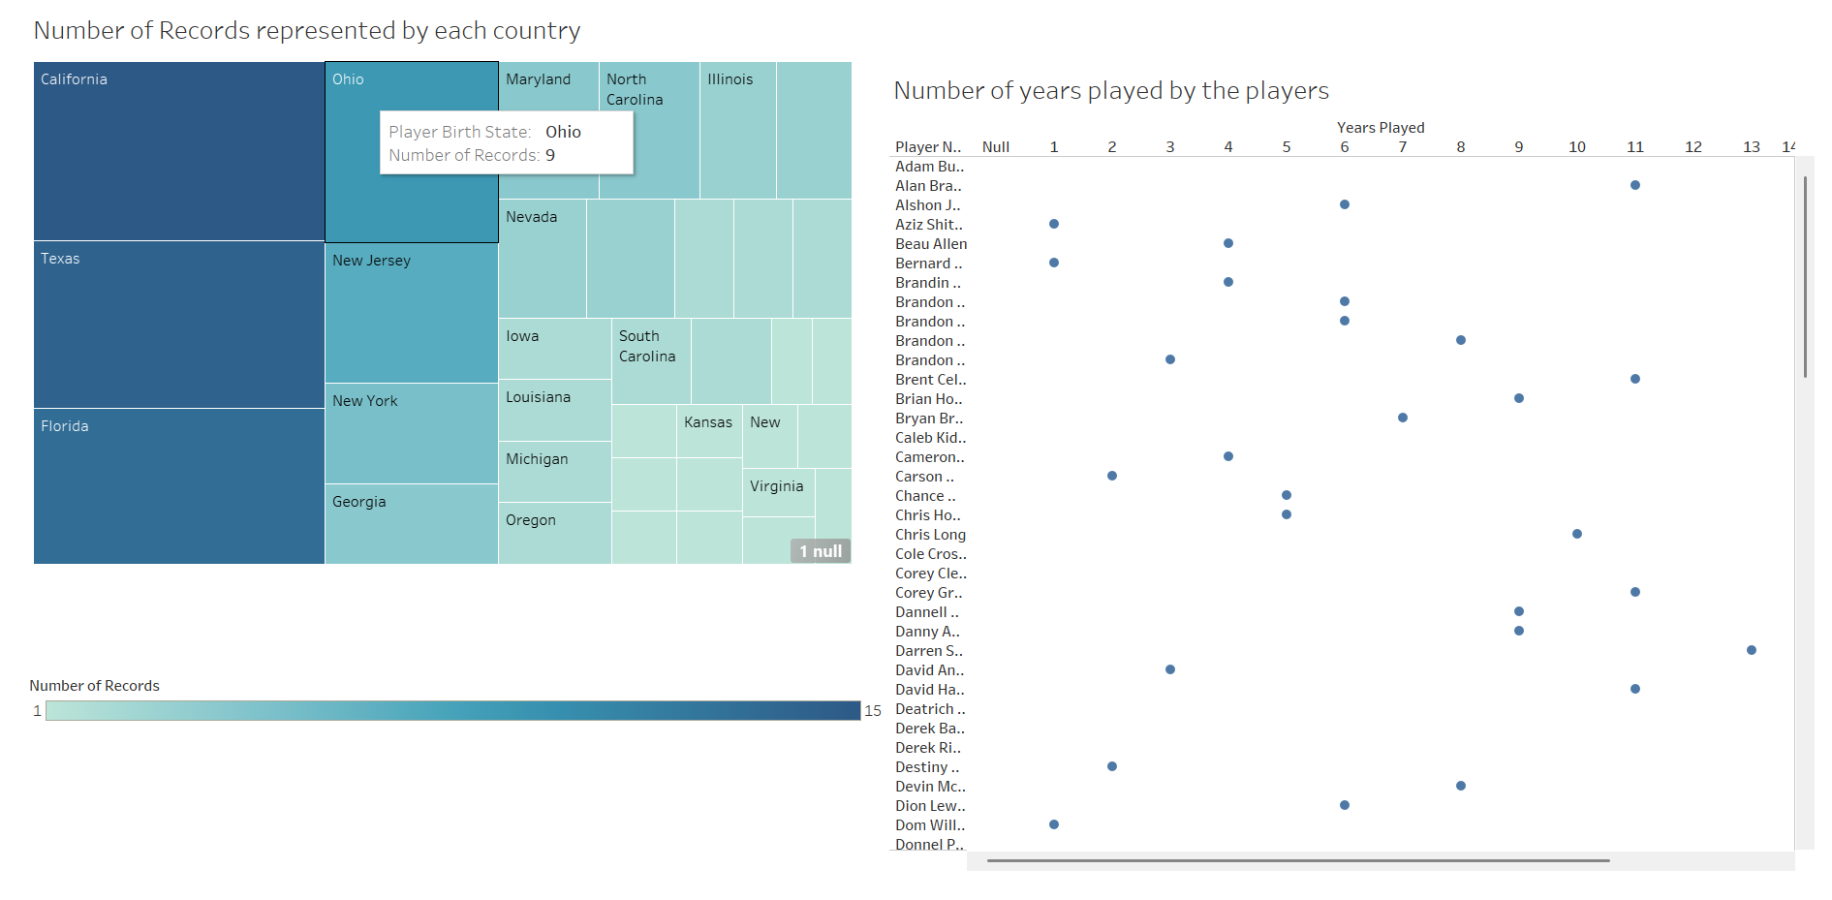

Slide 6
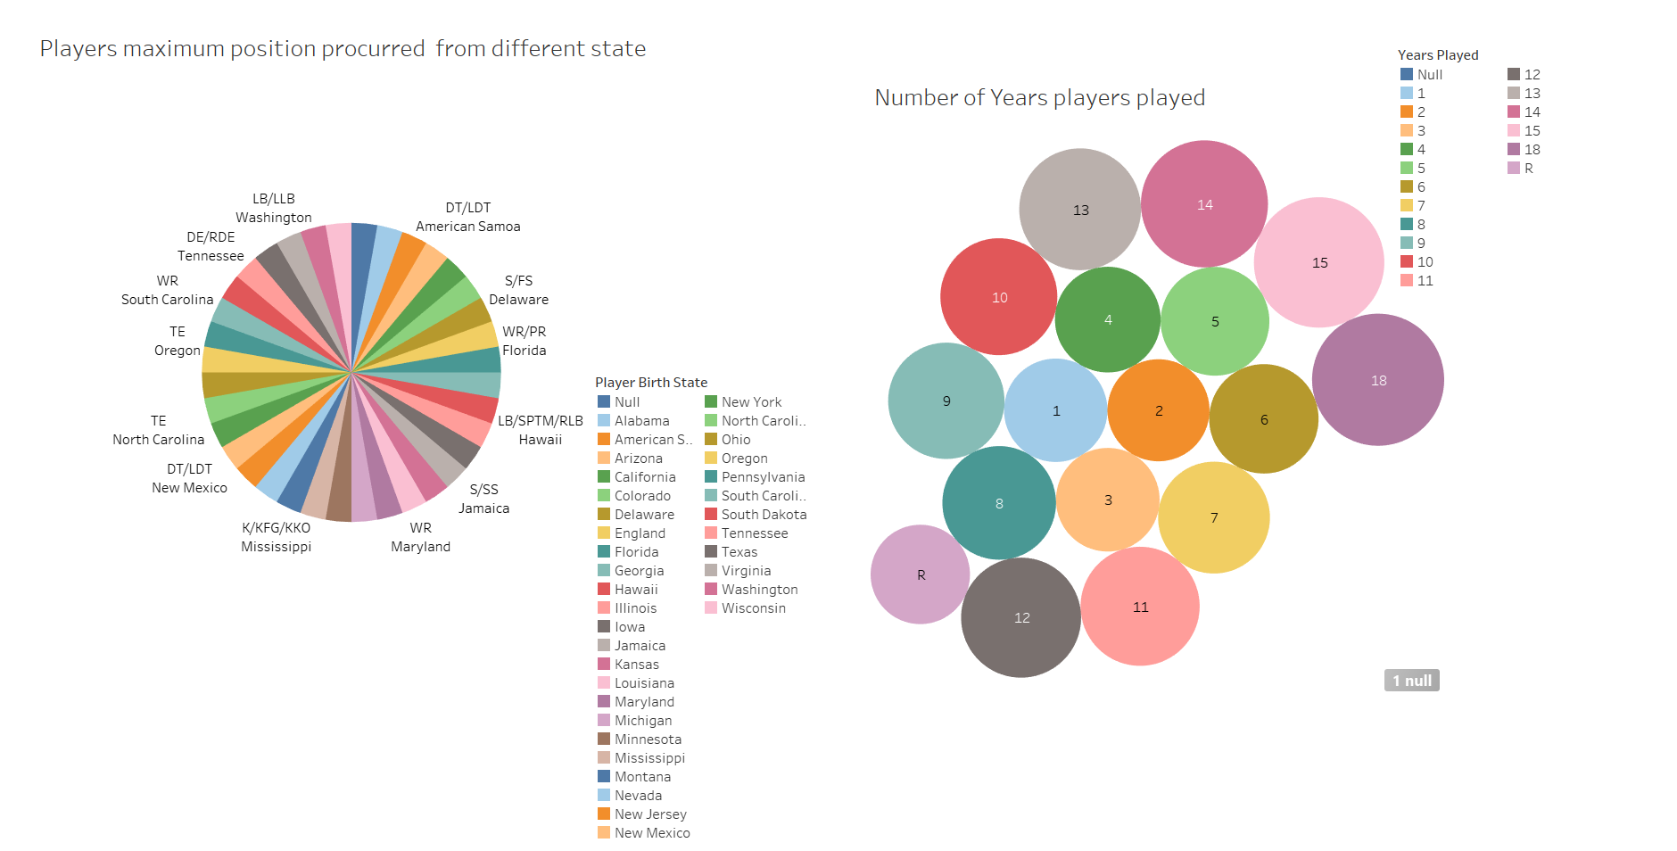

Slide 7




The Backstory: Data Nerds Seek New Rooting Interests
Playoff Elimination
1
The creators were disappointed after their teams were eliminated from the playoffs.
2
Data Exploration
They turned to data to find new teams and players to root for in the Super Bowl.
Census Data
3
They discovered a wealth of census data about player birthplaces and population figures.
Visualization Project
4
They decided to create a fun and engaging visualization to share their findings.
Notes:
5

Slide 8

Roster Data for the Competing Teams
Player Name
Position
Team
Birthplace
Tom Brady
Quarterback
New England Patriots
San Mateo, California
Rob Gronkowski
Tight End
New England Patriots
Amherst, New York
Nick Foles
Quarterback
Philadelphia Eagles
Austin, Texas
Zach Ertz
Tight End
Philadelphia Eagles
West Chester, Pennsylvania
Notes:
6

Slide 9
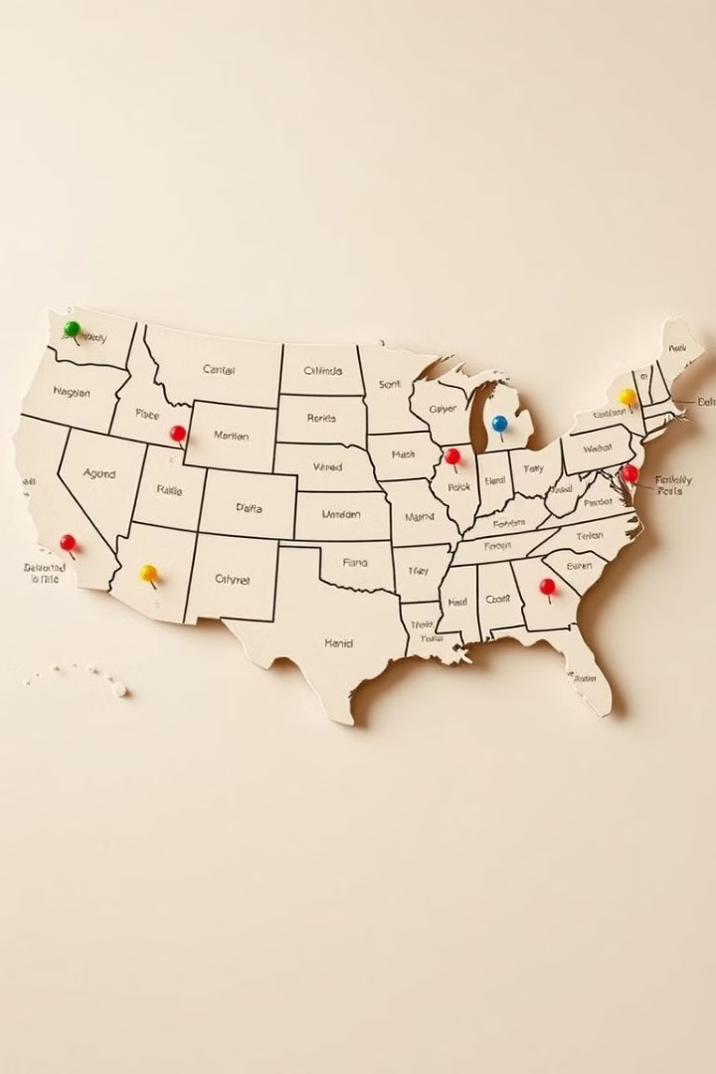



Birthplace Information for Each Player
Player Name
Each player's profile includes their name, position, and current team.
Birthplace
The interactive map allows users to explore player birthplaces and discover interesting patterns.
Population Data
Users can also view population figures for each player's hometown and compare them to other locations.
Notes:
7

Slide 10

Conclusion and Key Takeaways
This Big Game Census data visualization provides a fun and engaging look at the geographic origins of Super Bowl 52 players. The data reveals the diverse backgrounds of the athletes, highlighting the national scope of the game.
Notes:
8

